Slide 1

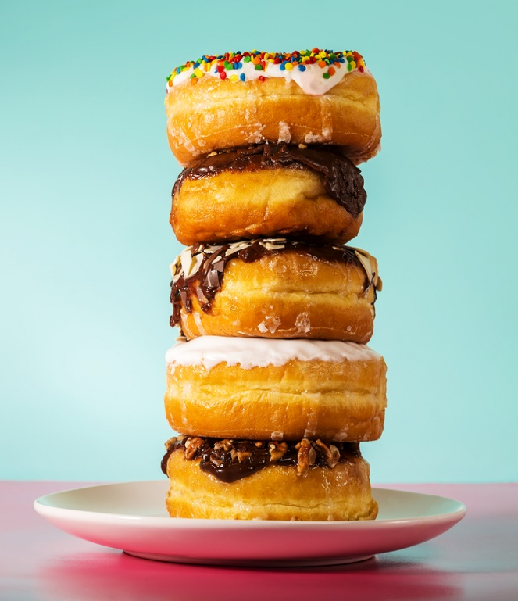





Home
Happiness is
Donut Shape!
Search …
Our Story
Menu
Contact Us

Slide 2
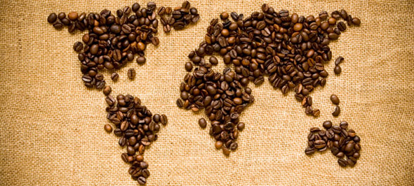
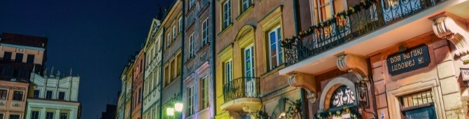
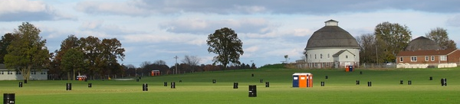

About Us
Our
Story
Donut Delights was started in 1971 by Melvin Furballski.
In 1970 he landed in New York City and by chance he found an open seat on a bus heading west. When an unexpected mechanical failure forced a three day delay in Champaign, Illinois, Furballski decided to stay and with only one hundred dollars to his name, he transformed an abandoned bread shop into C-U’s finest breakfast and coffee shop!
Notes:
http://www.freepik.com/free-icons

Slide 3
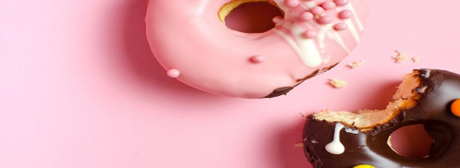
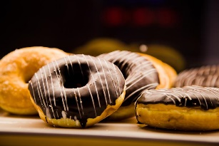
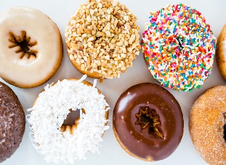
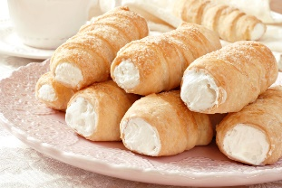
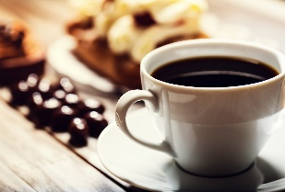
Menu
Fancy Donut:
bow tie, éclair, apple turnover, fancy coffee roll
…
Fancy Donut
Regular Donut :
chocolate frosted
vanilla frosted
boston cream
jelly filled
cream filled
chocolate glazed…
Regular Donut
Top sellers:
Pistachio Pinwheels
Boston Cream delights
Chocolate confetti
Marshmallow Mayhems
French twists
Bulls Horns…
Top Sellers
Latte Cappuccino Mocha Americano Espresso Fresh Brewed Coffee Hot Chocolate…
Coffee
Notes:
http://www.freepik.com/free-icons

Slide 4
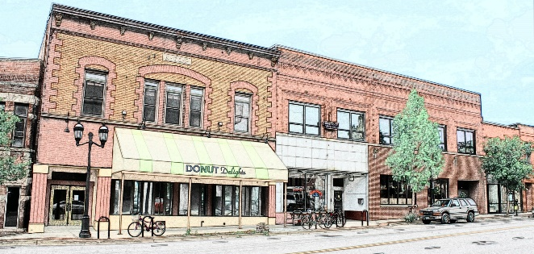



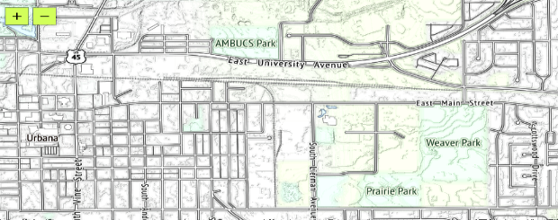
Contact Us
Visit Us!
Donut Delights
2112 main street Urbana , Illinois 61801
(217)-555- 1234
contact@donutdelights.com
Subscribe to our newsletter for our
seasonal offerings & special events:
Email
Comments
Notes:
http://www.freepik.com/free-icons

